Slide 1
Reading Project Medical Cannabis
Team:-
Harshal Daglia(Y13uc109)
Pawan Kumar(Y13uc192)
Intel Kancharla(Y13uc130)
Amit Rankawat(Y13uc023)
Course:- Bio Medical Engineering
Instructor:- Amit Neogi

Slide 2
Introduction
Medical Cannabis refer to the use of Cannabis and its Cannabinoids to treat disease or improve symptoms.[
Cannabinoids are a class of diverse chemical compounds isolated from Cannabis to act on cannabinoid receptors in cells that repress neurotransmitter release in the brain.
There are at least 113 different Cannabinoids isolated from cannabis, exhibiting varied effects.
At present, there are two known types of cannabinoid receptors, termed CB_{1(Brain)} and CB_{2(Immune System).}
_{Selective Breeding} is used to control the genetics of plants and modify the cannabinoids profile.

Slide 3
History of Cannabis
The earliest record of medical marijuana comes from ancient China.
Ancient Egyptians were the first to use cannabis as a treatment for tumors.
Medical marijuana was introduced to Western medicine in the mid-1800s.
In the 19th century cannabis was one of the secret ingredients in several patent medicines. There were at least 2000 cannabis medicines prior to 1937, produced by over 280 manufacturers.
Cannabis was listed in the United States Pharmacopeia from 1851 until 1941.
Since California became the first state to legalize medical marijuana in 1996, a dozen states have followed.

Slide 4

Formation of Cannabinoid Oil

Slide 5
Types of Cannabinoids
The Most notable Cannabinoid is the Phytocannabinoid Tetrahydrocannabinol[THC], Cannabidiol[CBD], Cannabinol[CBN].
The classical cannabinoids are derived from their respective 2-carboxylic acids (2-COOH) by decarboxylation.
CBG (Cannabigerol)
CBC (Cannabichromene)
CBL (Cannabicyclol)
CBV (Cannabivarin)
THCV (Tetrahydrocannabivarin)
CBDV (Cannabidivarin)
CBCV (Cannabichromevarin)
CBGV (Cannabigerovarin)
CBGM (Cannabigerol Monomethyl Ether)

Slide 6
Medical Value of Cannabis
Tested to provide Cure or Relief in following :-
Chronic Pain
Migraine Headaches
Nausea and Vomiting
Wasting Syndrome[AIDS]
Neurological Disorders
Posttraumatic Stress Disorder
Cancer
Brain Tumor
Glaucoma
Many more….

Slide 7
Self-Destructing Cancer Cell in Presence of Cannabinoid

Slide 8
Real Examples of Brain tumor and lung Cancer Cure

Slide 9
Cannabis Oil cures Leukemia of a Boy who had only Two Days to Live

Slide 10
Providing Relief in Wasting Syndrome[AIDS]
Around 35 million people worldwide are infected with the HIV virus, and since the 1980s, AIDS has caused approximately 36 million painful deaths. Cannabis has been shown to be extremely effective at treating several important symptoms of HIV/AIDS.
Appetite stimulant - A 2005 survey conducted on 523 HIV-positive patients found that 97% reported that they experienced improvements in appetite.
Anti-nausea - THC is approved by the US Food & Drug Administration for the treatment of nausea and appetite loss associated with cancer and HIV.
Mood-improving/antidepressant.
Reduces peripheral neuropathy - HIV/AIDS is peripheral neuropathy, in which one or more nerves of the peripheral nervous system become damaged and lead to pain, twitching, paresthesia, muscle loss and impaired coordination.
Many more….
A study published in 2013 by a Harvard University team found that CB2 activation may also prevent HIV from damaging the brain.

Slide 12
Medical Cannabis in Migranes
A new study published from Skaggs School of Pharmacy and Pharmaceutical Sciences at the University of Colorado looked at the effects of inhaled and ingested cannabis in migraine sufferers.
Researchers reviewed reports from 121 adult participants and collected the following data:
The average number of migraine headaches decreased from 10.4 per month to 4.6
Almost 40% of subjects reported positive effects
19.8% of subjects claimed medical marijuana helped to prevent migraines
11.6% of subjects reported that cannabis stopped migraine headaches
About 85% of subjects reported having fewer migraines per month with cannabis
About 12% saw no change in migraine frequency with cannabis

Slide 13
Medical Cannabis cure many more diseases
or provide relief

Slide 14
Points to remember befor using Cannabis
Smoking Marijuana is a poor way to deliver medicine. Additionally the harmful chemicals and carcinogens that are byproducts of smoking create entirely new health problems. According to the National Institutes of Health (NIH), Smoking one marijuana cigarette deposits about four times as much tar into the lungs as a filtered Tobacco cigarette.
As such there is no such Side Effects of using Cannabinoid but a person may have side effects like dizziness, drowsiness, feeling faint or lightheaded, fatigue, headache, dry mouth, fast heartbeat.
Do not drink alcohol while using cannabis. Alcohol will increase dizziness, drowsiness, and impaired judgment.
Strict Diet(alkaline rich diet) should be followed while using cannabis oil.
Doses of the Cannabis oil should be as prescribed or taken in a very small amount visit (http://www.cureyourowncancer.org/dosage.html) Cannabis is a Schedule 1 drug under the Controlled Substances Act.

Slide 15
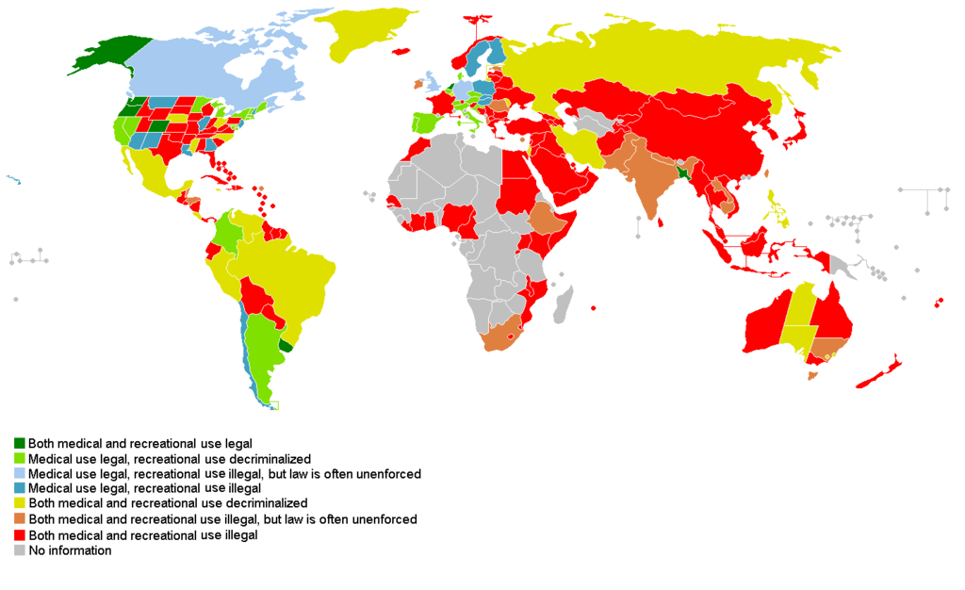
Legality of Cannabis by Country

Slide 16
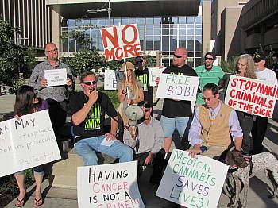


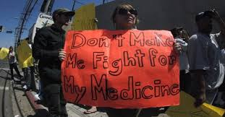




Slide 17
THANK U
STAY HEALTHY

